Slide 1
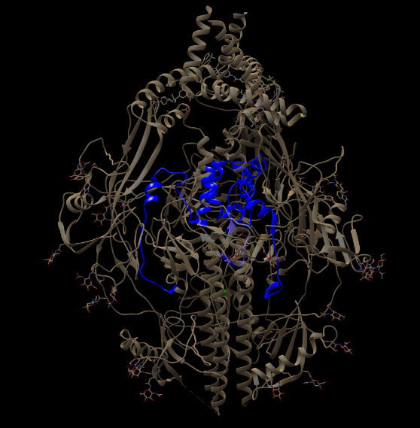
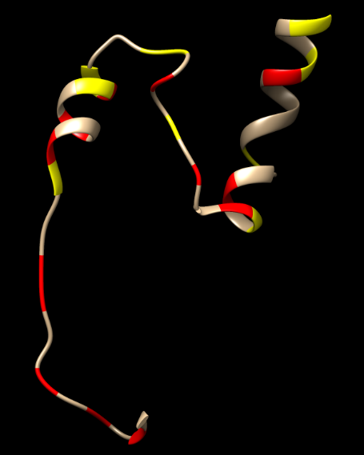
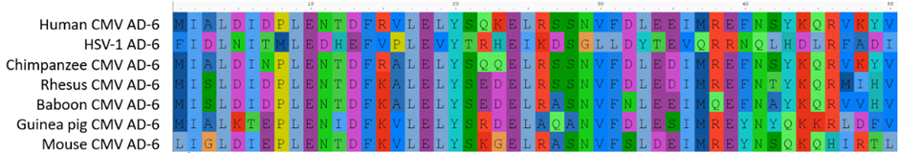
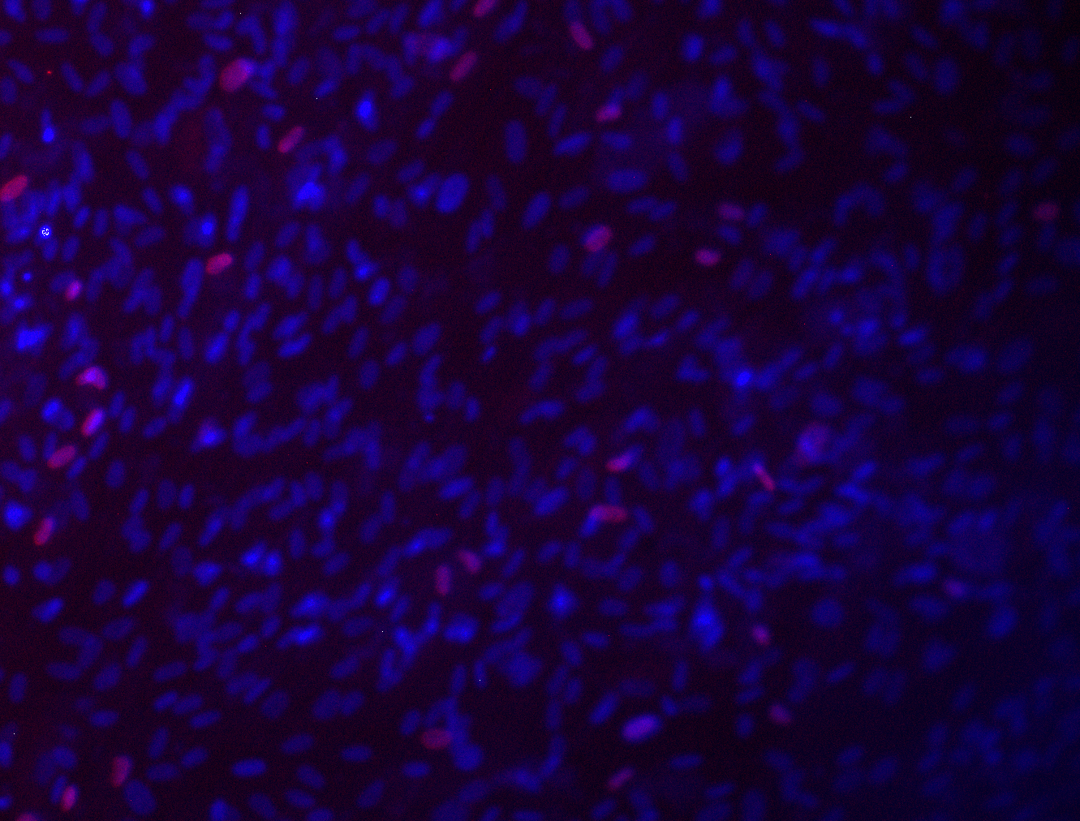
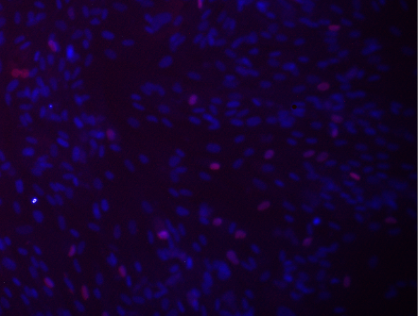
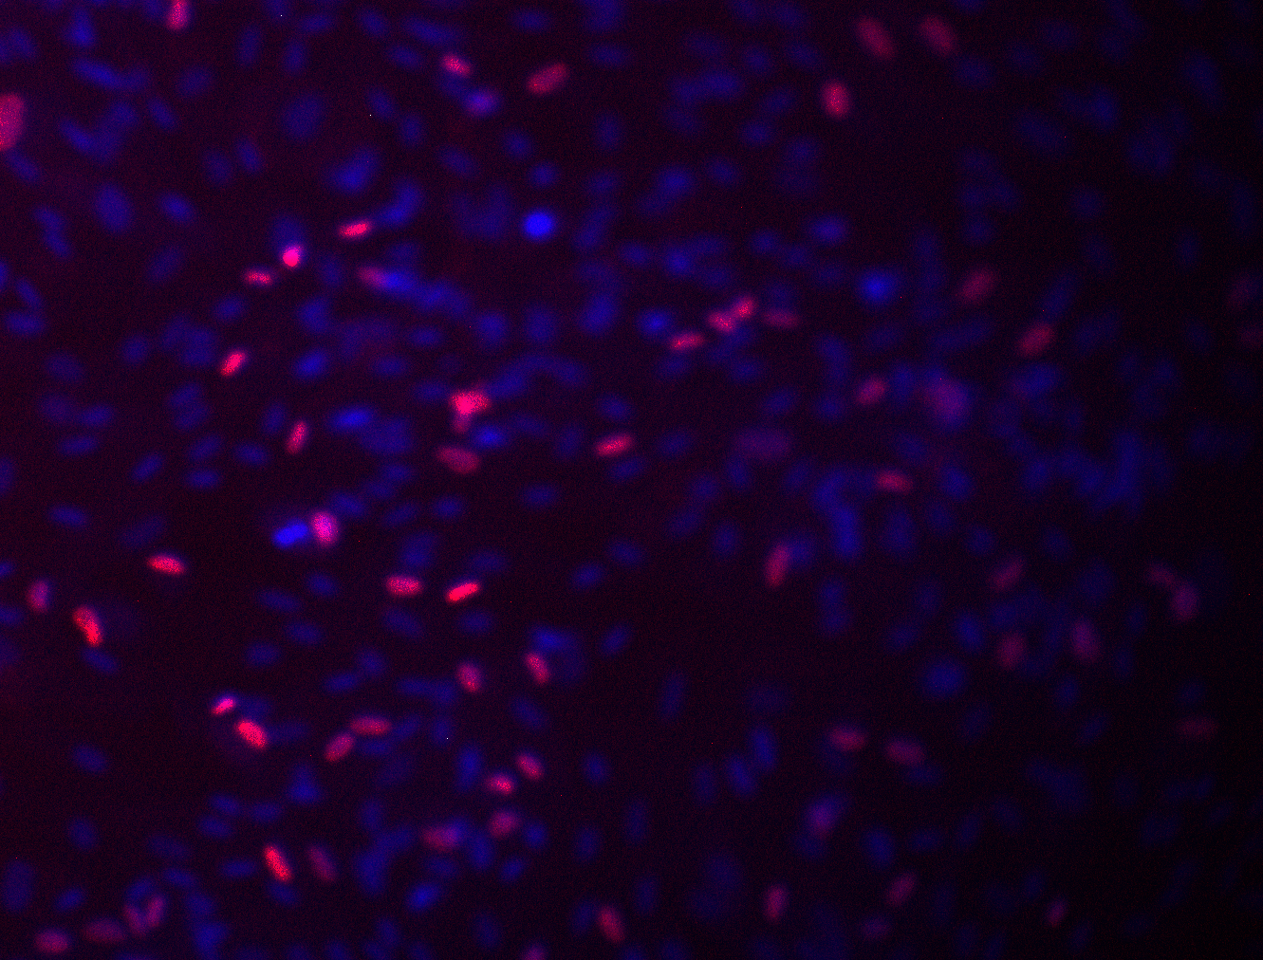
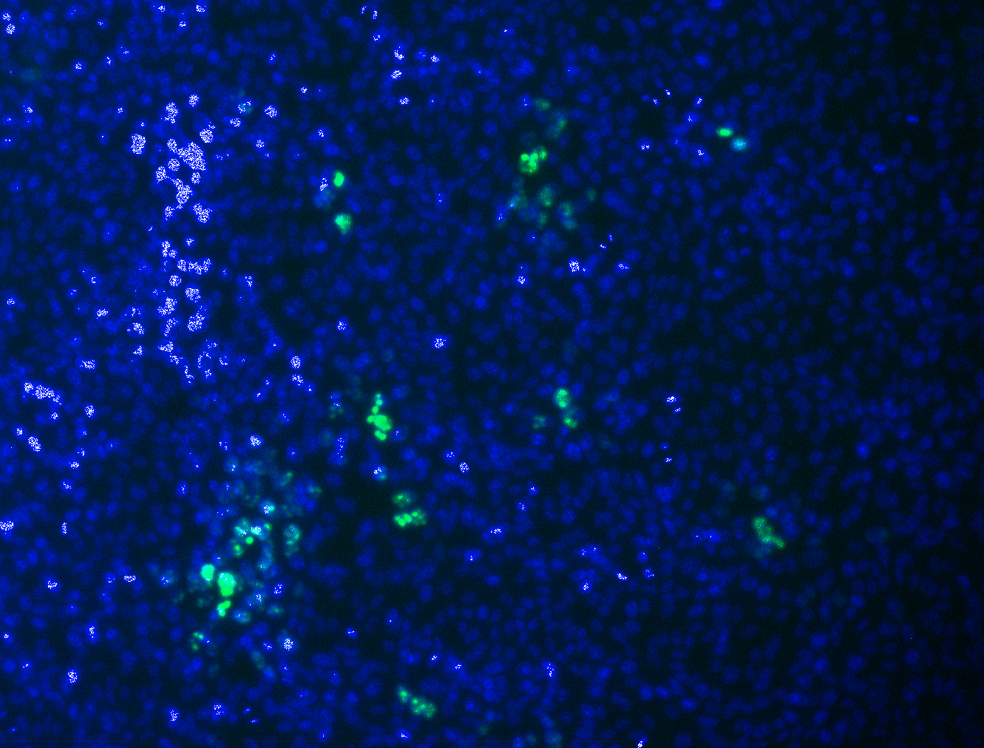
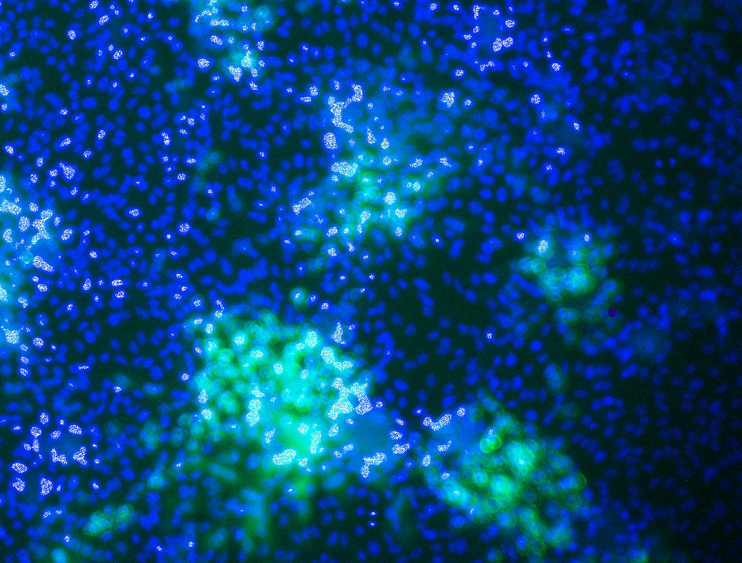
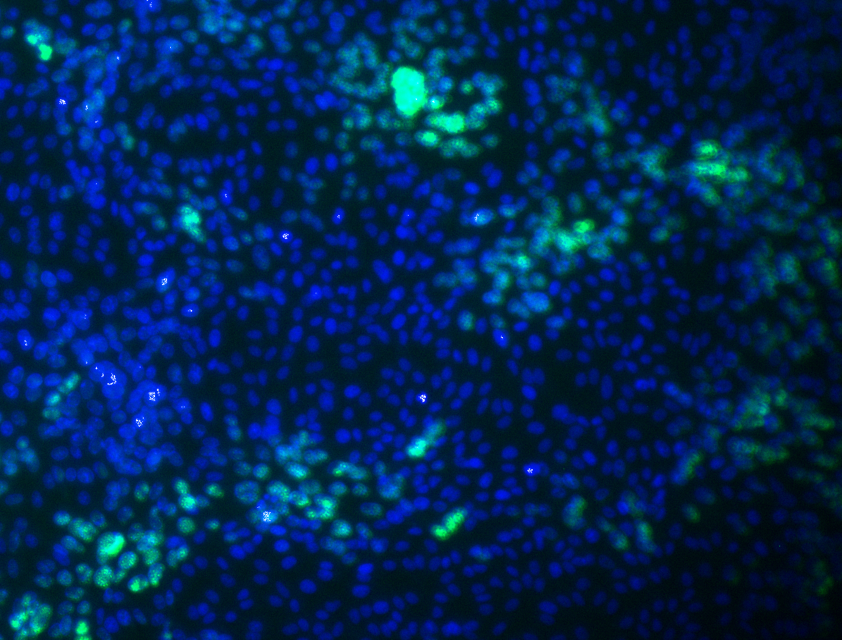
Use in-vitro assays to measure the impact of immune functions on viral replication, and perform mechanistic experiments to decipher the role of AD6 in HCMV biology
HCMV AD-6 structure and conservation with HSV-1 AD6
Sequence alignment of AD-6 across Cytomegaloviruses viruses and Herpes Simplex Virus 1
10
20
30
40
50
HSV-1 AD-6 peptide
HCMV AD-6 peptide
Virus only control
HCMV infection of Fibroblasts
Hypothesis 1: HSV-1 AD-6 peptide will have conserved functionality with HCMV AD-6 peptide and will be able to inhibit HSV-1 infection of fibroblasts and epithelial cells.
Hypothesis 2: HSV-1 AD-6 and HCMV AD-6 peptide will be able cross-reactively inhibit HCMV and HSV-1 infection, respectively.
HSV-1 infection of Epithelial cells
DTP funded by the MRC, Grant code: MR/W006774/1

Slide 2
Inhibition of HCMV infection
 | Fibroblasts | Epithelial cells
HCMV AD-6 |  | 
HSV-1 AD-6 |  | 
Conclusions:
HCMV AD-6 peptide only inhibits HCMV infection of fibroblasts not epithelial cells and shows no cross reactivity.
HSV-1 AD-6 peptide inhibits HSV-1 infection of both fibroblasts and epithelial cells and has cross-reactivity to inhibit HCMV in both cell types.
Future Work:
Repeat to enable accurate statistical tests
Try to uncover the interactions of AD-6 potentially by Surface Plasmon Resonance and His-tag chromatography
Inhibition of HSV-1 infection
 | Fibroblasts | Epithelial cells
HCMV AD-6 |  | 
HSV-1 AD-6 |  | 
DTP funded by the MRC, Grant code: MR/W006774/1

